Slide 1
Cyber security CS-597
Chapter 1
Introduction to security
Dr. Farhat Abbas

Slide 2
Challenges of securing information
Securing information
No simple solution
Many different types of attacks
Defending against attacks is often difficult

Slide 3
Today’s security attacks
Examples of recent attacks
Attack on a credit card processing company that handles prepaid debit cards
Taking control of wireless cameras
ATM machine attacks
Taking over Twitter accounts
Serial server attacks
Attackers using online sites such as Craigslist and eBay to lure victims to download malware
Penetration of Apple’s very own network

Slide 4
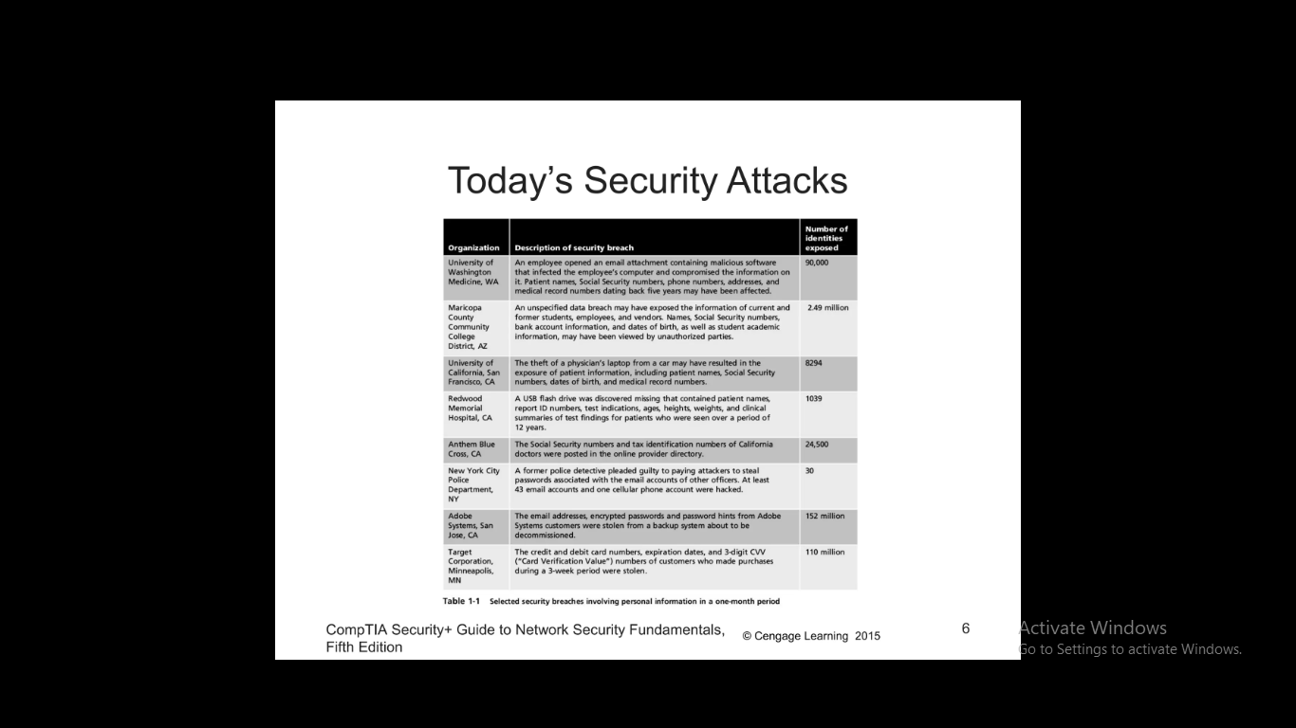
Today’s security attacks

Slide 5
Difficulties in defending against attacks
Universally connected devices
Increased speed of attacks
Greater sophistication of attacks
Availability and simplicity of attack tools
Faster detection of vulnerabilities
Delays in security updating
Weak security update distribution
Distributed attacks
Introduction of BYOD
User confusion

Slide 6
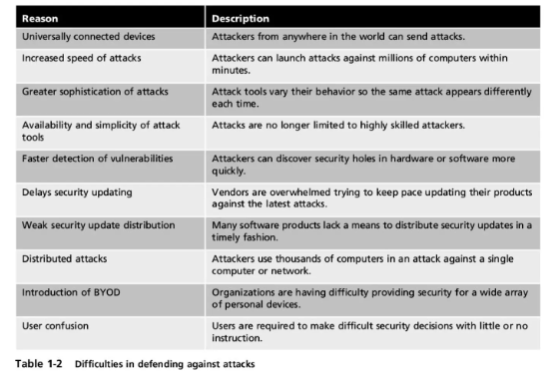
Difficulties in defending against attacks

Slide 7
What is information security?
Before defense is possible, one must understand:
Exactly what security is
How security relates to information security
The terminology that related to information security

Slide 8
Understanding security
Security is:
The goal to be free from danger
The process that achieves that freedom
Harm/dander may come from one of two sources:
From a direct action that is intended to inflict damage
From an indirect and unintentional action
As security is increased, convenience is often decreased
the more secure something is the less convenient it may become to use

Slide 9
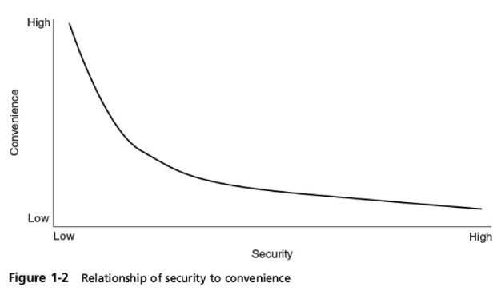
Understanding security

Slide 10
Defining information security
Information Security – the tasks of securing information that is in a digital format:
Manipulated by a microprocessor
Stored on a storage device
Transmitted over a network
Information security goal – to ensure that protective measures are properly implemented to ward off attacks and prevent the total collapse of the system when a successful attack occurs.

Slide 11
Defining Information Security
Three types of information protection: often called CIA
Confidentiality Only approved individuals may access information Integrity Information is correct and unaltered Availability Information is accessible to authorized users

Slide 12
Defining Information Security
Authentication Ensures the individual is who they claim to be Authorization Provides permission or approval to specific technology resources Accounting Provides tracking of events

Slide 13
Defining Information Security
Information security is achieved through a process that is a combination of three entities:
Information and the hardware
Software
Communications
These entities are protected in three layers:
Products
People
Policies and procedures

Slide 14
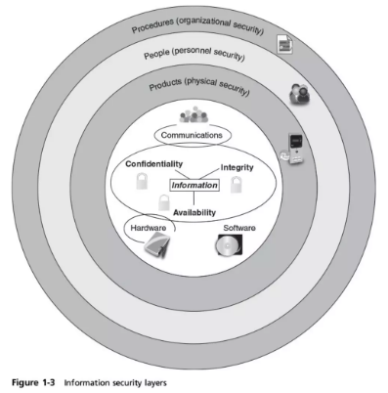
Defining Information Security

Slide 15
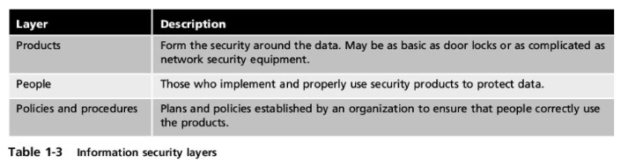
Defining Information Security

Slide 16
Information Security Terminology
Asset Item that has value
Threat Type of action that has the potential to cause harm
Threat agent A person or element with power to carry out a threat

Slide 17
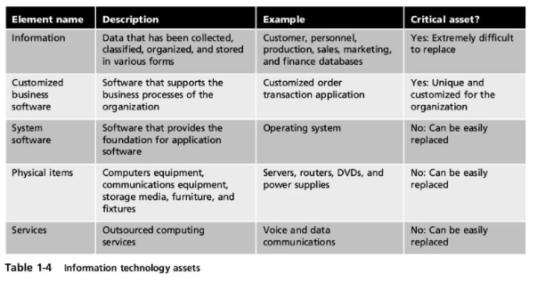
Information Security Terminology

Slide 18
Information Security Terminology
Vulnerability Flaw or weakness that allows a threat agent to bypass security
Threat vector The means by which an attack can occur
Threat likelihood Likelihood that threat agent will exploit vulnerability
Risk A situation that involves exposure to some type of danger

Slide 19
Information Security Terminology
Options to deal with risk: Risk avoidance - involves identifying the risk but not engaging in the activity Acceptance - risk is acknowledged but no steps are taken to address it Risk mitigation - the attempt to address the risks by making risk less serious Deterrence - understanding the attacker and then informing him of the consequences of his actions Transference - transferring the risk to a third party

Slide 20
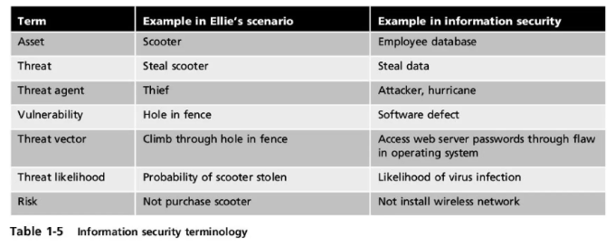
Information Security Terminology

Slide 21
Understanding the Importance of Information Security
Information security can be helpful in:
Preventing data theft
Thwarting identity theft
Avoiding the legal consequences of not securing information
Maintaining productivity
Foiling cyberterrorism

Slide 22
Preventing Data Theft
Preventing data from being stolen is often the primary objective of an organization’s information security
Business data theft involves stealing proprietary business information
Personal data theft involves stealing credit card numbers

Slide 23
Thwarting Identity Theft
Identity theft Stealing another person’s personal information Usually using it for financial gain Example: Steal person’s SSN Create new credit card account to charge purchases and leave them unpaid File fraudulent tax returns

Slide 24
Avoiding Legal Consequences
Laws protecting electronic data privacy:
The Health Insurance Portability and Accountability Act of 1996 (HIPAA)
The Sarbanes-Oxley Act of 2002 (Sarbox)
The Gramm-Leach-Bliley Act (GLBA)
Payment Card Industry Data Security Standard (PCI DSS)
California’s Database Security Breach Notification Act (2003)

Slide 25
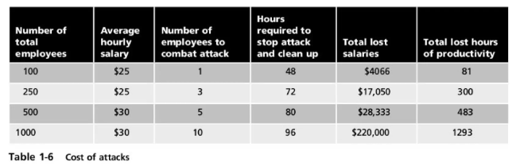
Maintaining Productivity
Post-attack clean up diverts resources away from normal activities Time, money, and other resources

Slide 26
Foiling Cyberterrorism
Cyberterrorism Any premeditated, politically motivated attack against information, computer systems, computer programs, and data Designed to:
Cause panic
Provoke violence
Result in financial catastrophe
May be directed at targets such as the banking industry, power plants, air traffic control centers, and water systems

Slide 27
Who Are the Attackers?
Hacker - person who uses computer skills to attack computers Black hat hackers Violate computer security for personal gain and the goal is to inflict malicious damage White hat hackers Goal to expose security flaws, not to steal or corrupt data Gray hat hackers Goal is to break into a system without owner’s permission, but not for their own advantage

Slide 28
Who Are the Attackers?
Categories of attackers
Cybercriminals
Script kiddies
Brokers
Insiders
Cyberterrorists
Hacktivists
State-sponsored attackers

Slide 29
Cybercriminals
A network of attackers, identity thieves, spammers, financial fraudsters More highly motivated Willing to take more risk Well-funded More tenacious The goal of a cybercriminal is financial gain
Cybercrime - targeted attacks against financial networks and the theft of personal information

Slide 30
Cybercriminals
Financial cybercrime is divided into two categories: Individuals and businesses Use stolen data, credit card numbers, online financial account information, or Social Security numbers to profit from victims
Businesses and governments Attempt to steal research on a new product so they can sell it to an unscrupulous foreign supplier
Advanced Persistent Threat (APT) - multiyear intrusion campaign that targets highly sensitive economic, proprietary, or national security information

Slide 31
Script Kiddies
Cybercriminals- individuals who want to attack computers yet they lack the knowledge of computers and network needed to do so They download automated hacking software (scripts) from websites Over 40 percent of attacks require low or no skills Exploit kits - automated attack package that can be used without an advanced knowledge of computers Script kiddies either rent or purchase them

Slide 32
Brokers
Brokers - attackers who sell knowledge of a vulnerability to other attackers or governments
Often hired by the vendor to uncover vulnerabilities Instead they do not report it to the vendor but sell the information about the vulnerabilities to the highest bidder

Slide 33
Insiders
Employees, contractors, and business partners Over 48 percent of breaches attributed to insiders Examples of insider attacks: Health care worker may publicize celebrities’ health records Disgruntled over upcoming job termination Stock trader might conceal losses through fake transactions Employees may be bribed or coerced into stealing data before moving to a new job

Slide 34
Cyberterrorists
Cyberterrorists - an attacker whose motivation may be ideological or for the sake of principles or beliefs Almost impossible to predict when or where the attack may occur Targets may include: A small group of computers or networks that can affect the largest number of users Example: Computers that control the electrical power grid of a state or region

Slide 35
Hacktivists
Cybercriminals - attackers who attack for ideological reasons that are generally not as well-defined as a cyberterrorist’s motivation Examples of hacktivist attacks: 1. Breaking into a website and changing the contents on the site to make a political statement 2. Disabling a website belonging to a bank because the bank stopped accepting payments that were deposited into accounts belonging to the hacktivists

Slide 36
State-Sponsored Attackers
State-sponsored attacker - an attacker commissioned by the governments to attack enemies’ information systems May target foreign governments or even citizens of the government who are considered hostile or threatening
Examples of attacks: Malware targeting government or military computers Citizens having their email messages read without their knowledge

Slide 37
Attacks and Defenses
A wide variety of attacks can be launched
The same basic steps are used in most attacks
To protect computers against attacks follow five fundamental security principles

Slide 38
Steps of an Attack
Cyber Kill Chain outlines the steps of an attack:
1. Reconnaissance - probe for information about the system: type of hardware or software used
2. Weaponization - attacker creates an exploit and packages it into a deliverable payload
3. Delivery - weapon is transmitted to the target
4. Exploitation - after weapon is delivered, the exploitation stage triggers the intruder’s exploit
5. Installation - the weapon is installed to either attack the computer or install a remote “backdoor”
6. Command and Control - the comprised system connects back to the attacker so that the system can be remotely controlled by the attacker
7. Action on Objectives - now the attackers can start to take actions to achieve their original objectives

Slide 39
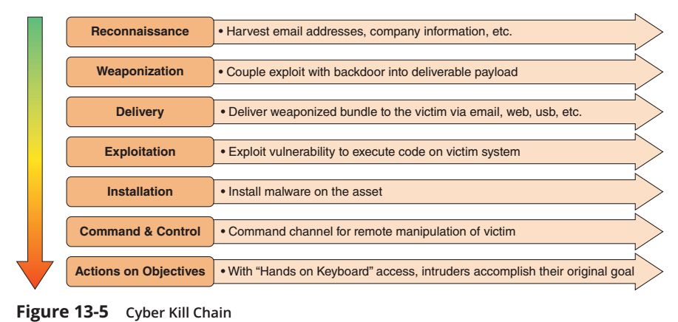
Steps of an Attack
Cyber Kill Chain. A kill chain is a military term used to describe the systematic process to target and engage an enemy. An attacker who attempts to break into a web server or computer network follows these same steps. Known as the Cyber kill Chain, it outlines the steps of an attack. Figure 13-5 shows the Cyber Kill Chain. The purpose of the Cyber Kill Chain is to illustrate that attacks are an integrated and end to-end process like a “chain.” Disrupting any one of the steps will interrupt the entire attack process, but the ability to disrupt the early steps of the chain is the most effective and least costly.

Slide 40
Defenses Against Attacks
Five fundamental security principles for defenses:
Layering
Limiting
Diversity
Obscurity
Simplicity

Slide 41
layering
Information security must be created in layers
A single defense mechanism may be easy to circumvent
Making it unlikely that an attacker can break through all defense layers
Layered security approach
Can be useful in resisting a variety of attacks
Provides the most comprehensive protection

Slide 42
limiting
Limiting access to information:
Reduces the threat against it
Only those who must use data should be granted access
Should be limited to only what they need to do their job
Methods of limiting access
Technology-based - such as file permissions
Procedural - such as prohibiting document removal from premises

Slide 43
diversity
Closely related to layering
Layers must be different (diverse)
If attackers penetrate one layer:
Same techniques will be unsuccessful in breaking through other layers
Breaching one security layer does not compromise the whole system
Example of diversity
Using security products from different manufacturers

Slide 44
obscurity
Obscuring inside details to outsiders
Example: not revealing details
Type of computer
Operating system version
Brand of software used
Difficult for attacker to devise attack if system details are unknown

Slide 45
simplicity
Nature of information security is complex
Complex security systems:
Can be difficult to understand and troubleshoot
Are often compromised for ease of use by trusted users
A secure system should be simple from the inside
But complex from the outside

Slide 46
Summary
Information security attacks have grown exponentially in recent years It is difficult to defend against today’s attacks Information security protects information’s integrity, confidentiality, and availability: On devices that store, manipulate, and transmit information Using products, people, and procedures Main goals of information security Prevent data theft Thwart identity theft Avoid legal consequences of not securing information Maintain productivity Foil cyberterrorism Different types of people with different motivations conduct computer attacks An attack has seven general steps known as the Cyber Kill Chain

Slide 47
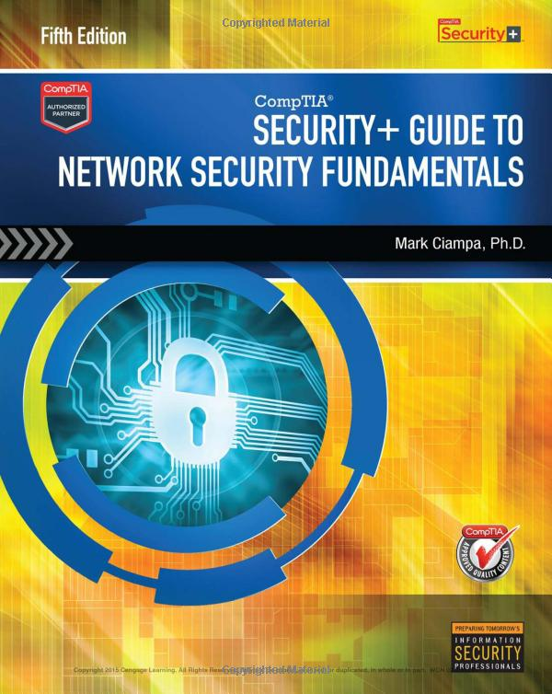
Reference Book
CompTIA Security+ Guide to Network Security Fundamentals, Fifth Edition

